Slide 1
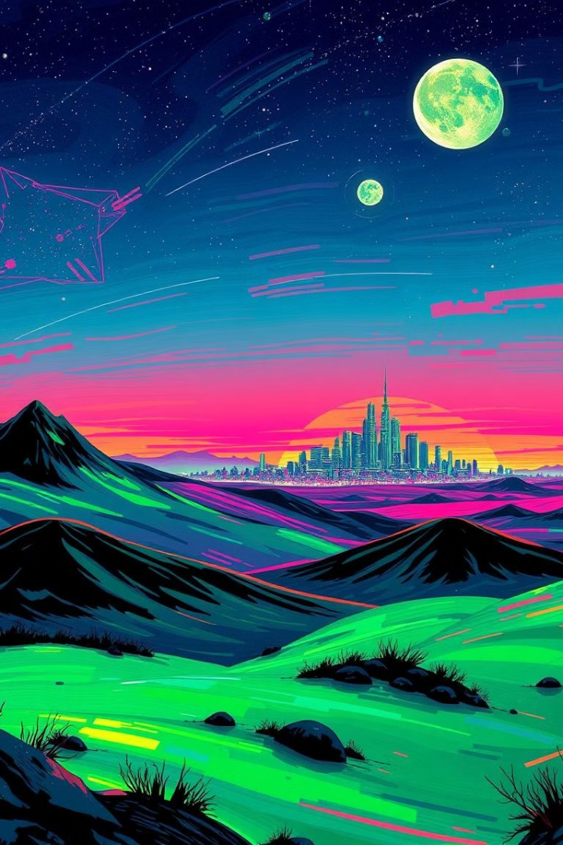
Introduction to Game Development
A fusion of creativity, technology, and storytelling. Combines disciplines like art, design, programming, sound, and more. Purpose: Create engaging, interactive experiences for players.
- by Kiran and Subash

Slide 2

Why Game Development Matters?
Cultural Expression
Entertainment & Education
Blends technology with cultural expression.
Supports entertainment, education, and innovation.
Community & Contributions
Drives the gaming community and regional contributions.

Slide 3
Core Components
Game Design
Art & Animation
Programming
Sound & Music
Blueprint for concepts, rules, mechanics, and story.
Visual creation and animation to bring elements to life.
Code for mechanics, engines, and performance.
Enhances mood and immersion.

Slide 4
Game Development Process
1
Conceptualization: Brainstorming and outlining ideas.
2
Pre-production: Prototyping and resource allocation.
3
Production: Collaboration to build the game.
4
Testing: Rigorous quality checks.
5
Launch: Release to the public.
6
Post-launch: Updates, patches, and new content.

Slide 5
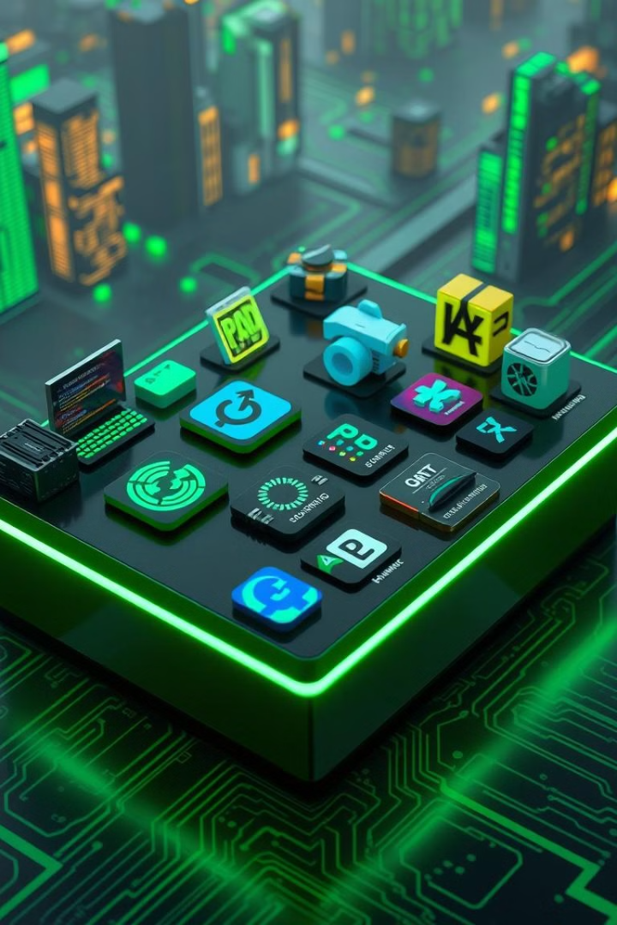
Tools and Technologies
Game Engines
Graphic Design
Unity
Adobe Photoshop
Unreal Engine
Illustrator
Godot
Blender
Raylib
Programming Languages
Sound Design
Audacity
C++
FMOD
C#
Python

Slide 6
Popular Games and Tech Stacks
Mobile Games
PC/Console Games
PUBG Mobile: Unreal Engine, C++.
Valorant: Custom engine, C++.
Garena Free Fire: Unity, C#.
Dota 2: Source 2 engine, Lua, and C++.
Ludo King: Unity, C#.
Raji: An Ancient Epic: Unreal Engine, Python.

Slide 7
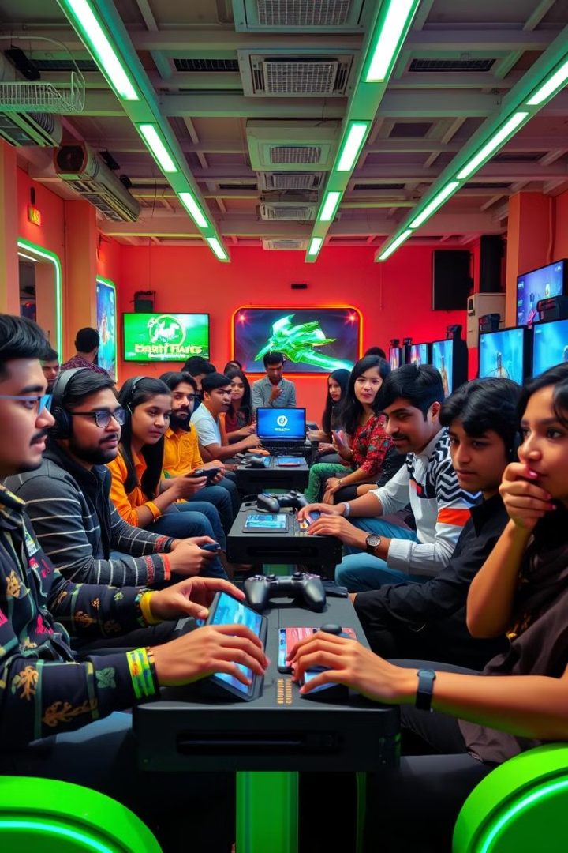



Regional Favorites in South Asia
Teen Patti
FIFA Series
Developed in Unity, targeting mobile platforms.
Frostbite engine, C++.
Raji: An Ancient Epic
Indian culture and mythology.

Slide 8
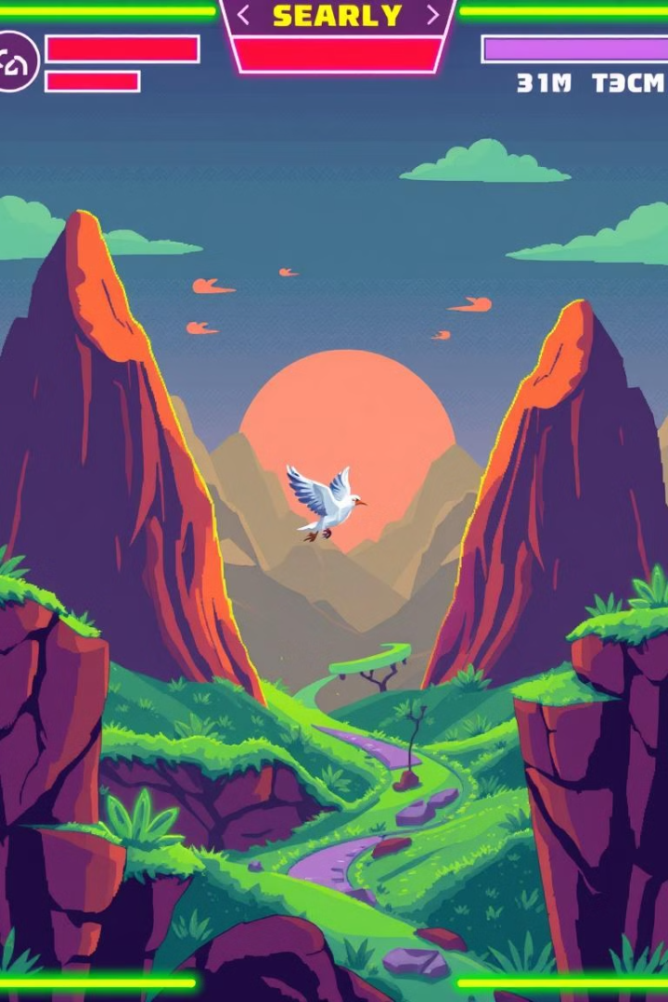




Live Game Development Projects
Language
C.
Framework
Raylib.
Focus
Lightweight and high performance.
Title
Floppy Bird

